Slide 1
Square World
Attack of the Roundies
Michael Wolf

Slide 2
Game Description
Genre – Puzzle RPG
Setting – Cube shaped planet
Story – Alien Invasion (The Roundies).
Target Audience – 3+
Screen – Swipe Gestures

Slide 3
GamePlay
Controls – Swipe Gestures
Skills- Puzzle Solving
Core Game Flow – Load a level, swipe to move around the level, attack and defeat enemies, earn rewards, return to map screen.
Rewards – up to 3 stars earned per level, coins, experience points, items and equipment.
Progression – Difficulty increase, more enemies per level, ‘smarter’ AI in later levels.

Slide 4
Features
Different Menus
Stats Menu
Equipment and items
World Select Menu
Shops
Level and experience bar
Health bar and current moves score.
Level based gameplay

Slide 5
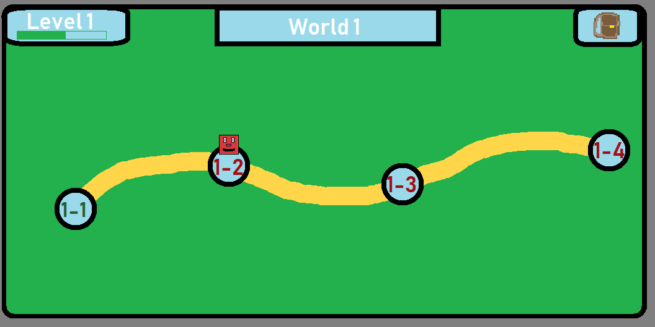
Resources and UI Design
Fig 1: Ui Map concept

Slide 6
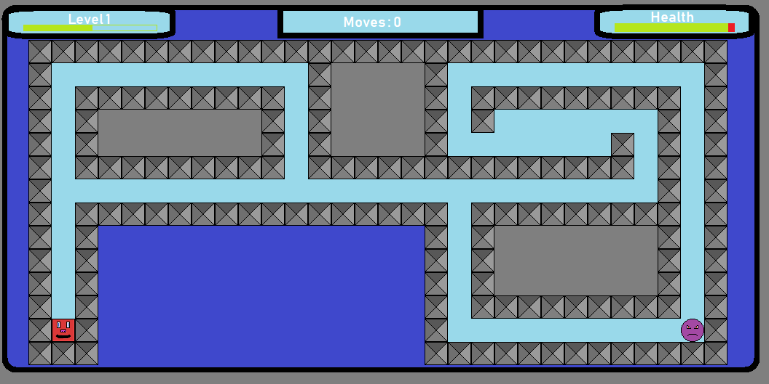
Resources and UI Design
Fig 2: Ui design concept

Slide 7
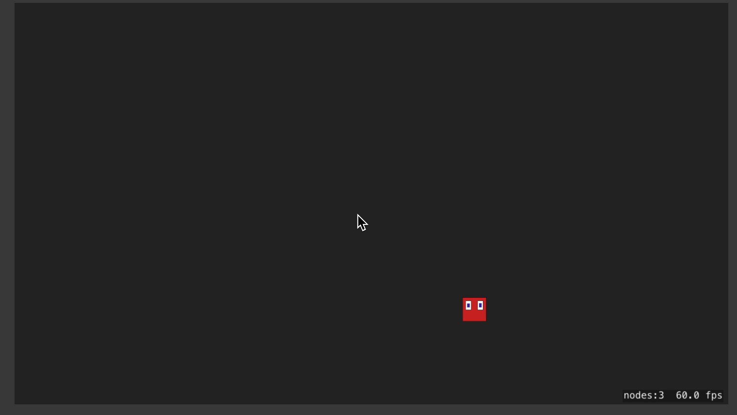
Resources and UI Design

Slide 8
Use of iOS Game Frameworks
SpriteKit
Sprites,
Sounds
Scenes
Animations
Effects
GamePlayKit
Artificial intelligence
Pathfinding and agent behavior.
Random number generation

Slide 9


Thank you!
Any Questions?

